Slide 1
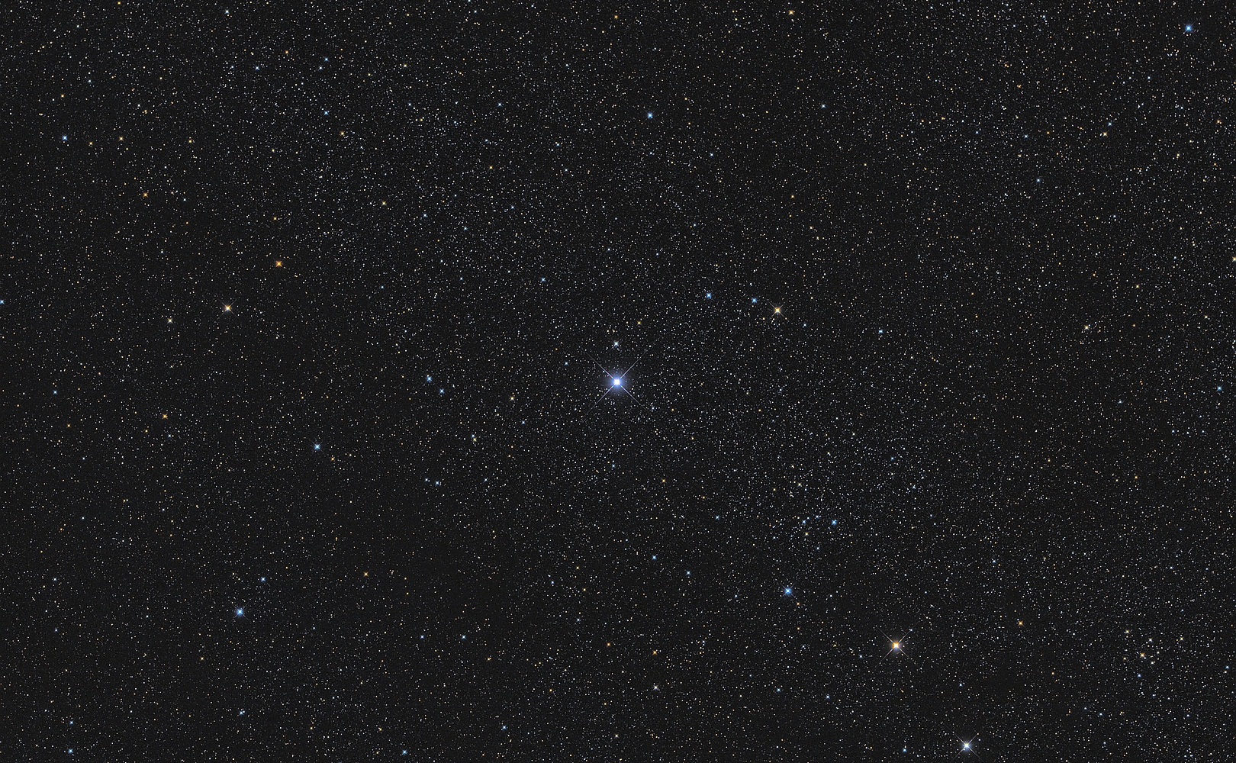
Stellar classification
Dataset: Sloan Digital Sky Survey DR17, 100 000 observations, 17 feature columns, 3 classes
Business Case: Suppose a team of astrophysicists needs a model to classify celestial objects reliably. Given the high cost associated with further research on classified objects, maximizing the precision of the classification model is paramount.
Metrics: weighted precision, accuracy
Authors: Igor Kołodziej, Kamil Eliaszuk

Slide 2
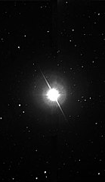
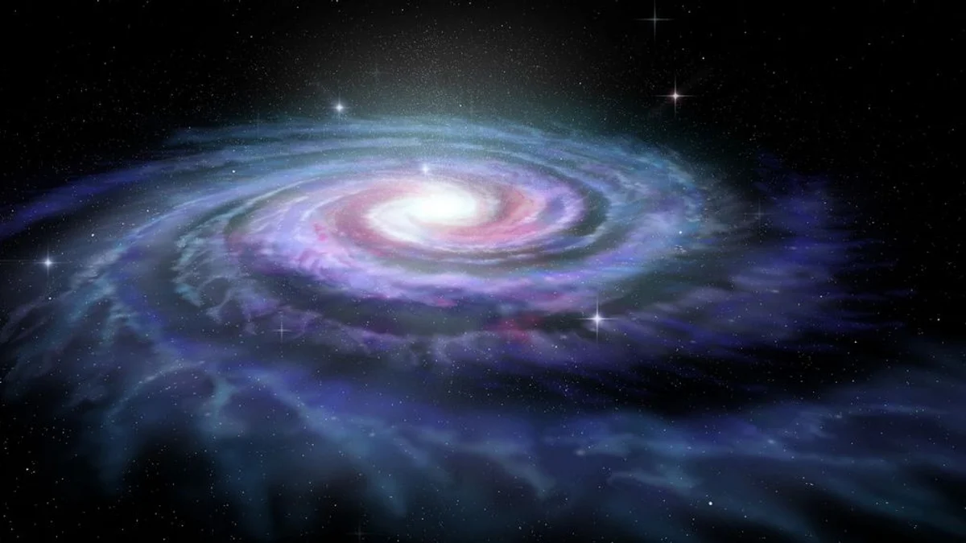
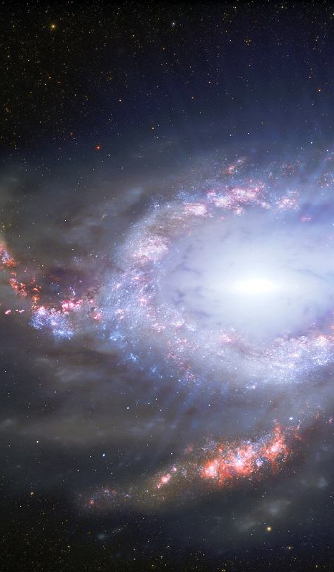
Stars
Distance from earth:
~ light-years
Galaxies
Distance from earth:
~ millions of light-years
Quasars
Distance from earth:
~ billions of light-years

Slide 3
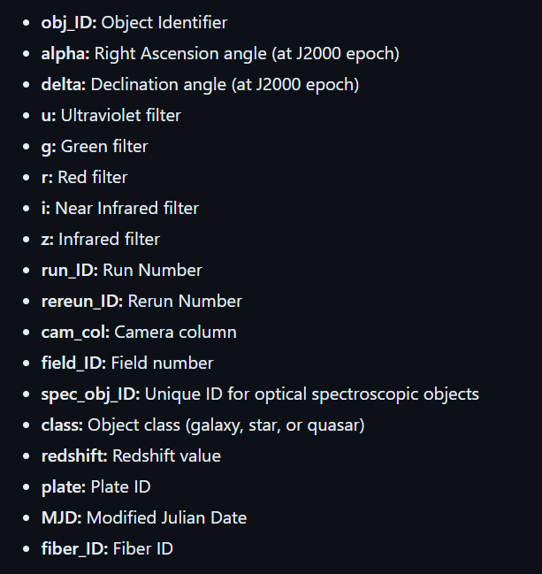
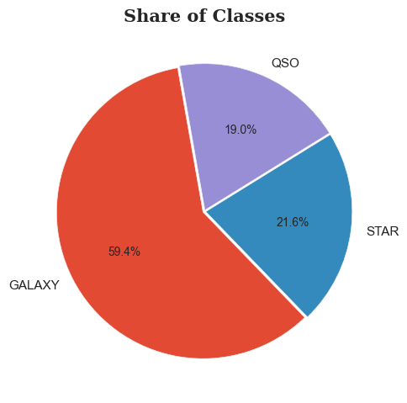
A look at the data

Slide 4
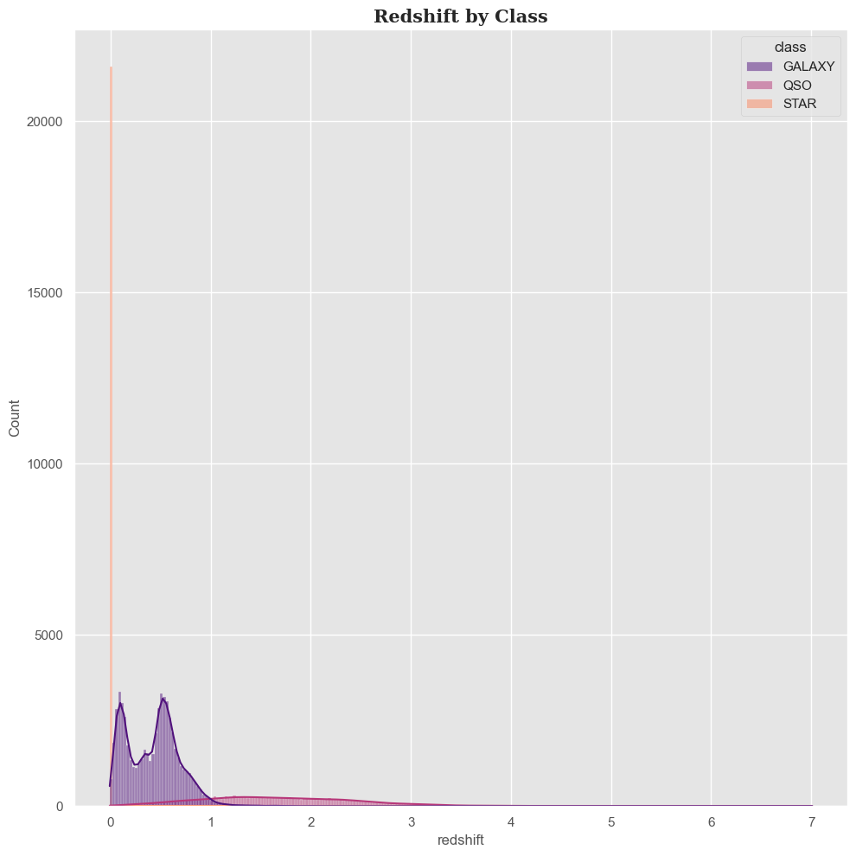
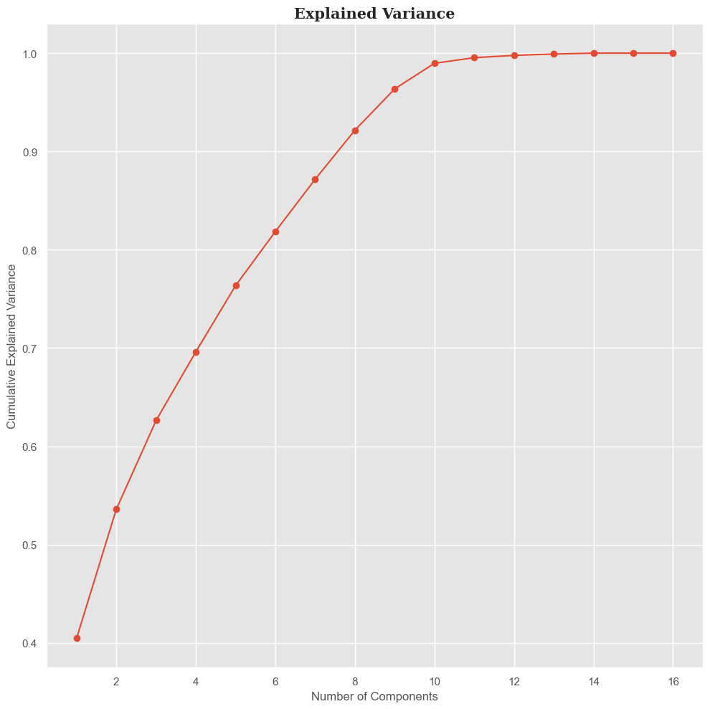
A look at the data
Key feature:
redshift (proportional to the distance from the earth)
PCA: high explainability with a low number of components

Slide 5
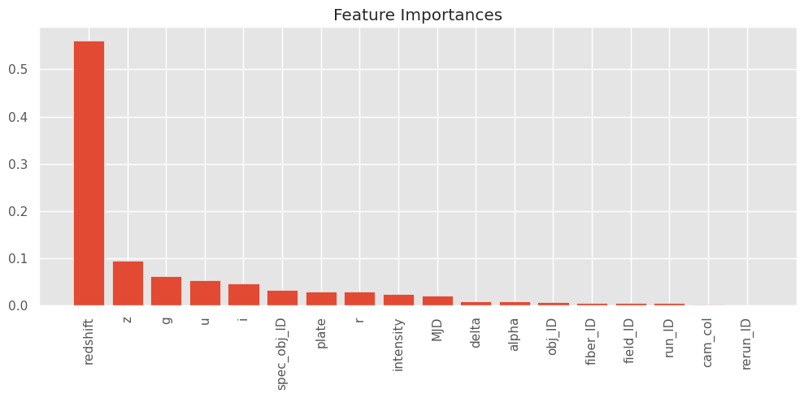
Data preparation
No missing data
Only continuous features
Target class encoding
Feature standarization
Feature selection
Random forest feature importance

Slide 6
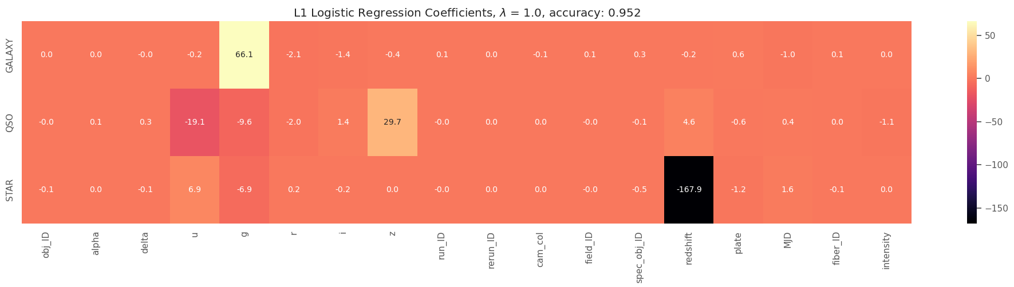
Data preparation
Logistic regression with regularization
We reject variables of the type ID, date, or variables that are strongly correlated with each other.
We only leave 4 features: u, g, z and redshift.
The model practically does not lose accuracy, but it is much simpler and easier to explain.

Slide 7
Model choice
Hyperparameter tuning – Bayesian optimalization
Best models of different types (weighted precision):
Random forest: 0.977
SVM: 0.970
XGBoost: 0.974
Regresja logistyczna: 0.959
Stacking: 0.977 – high score but not higher than RF

Slide 8
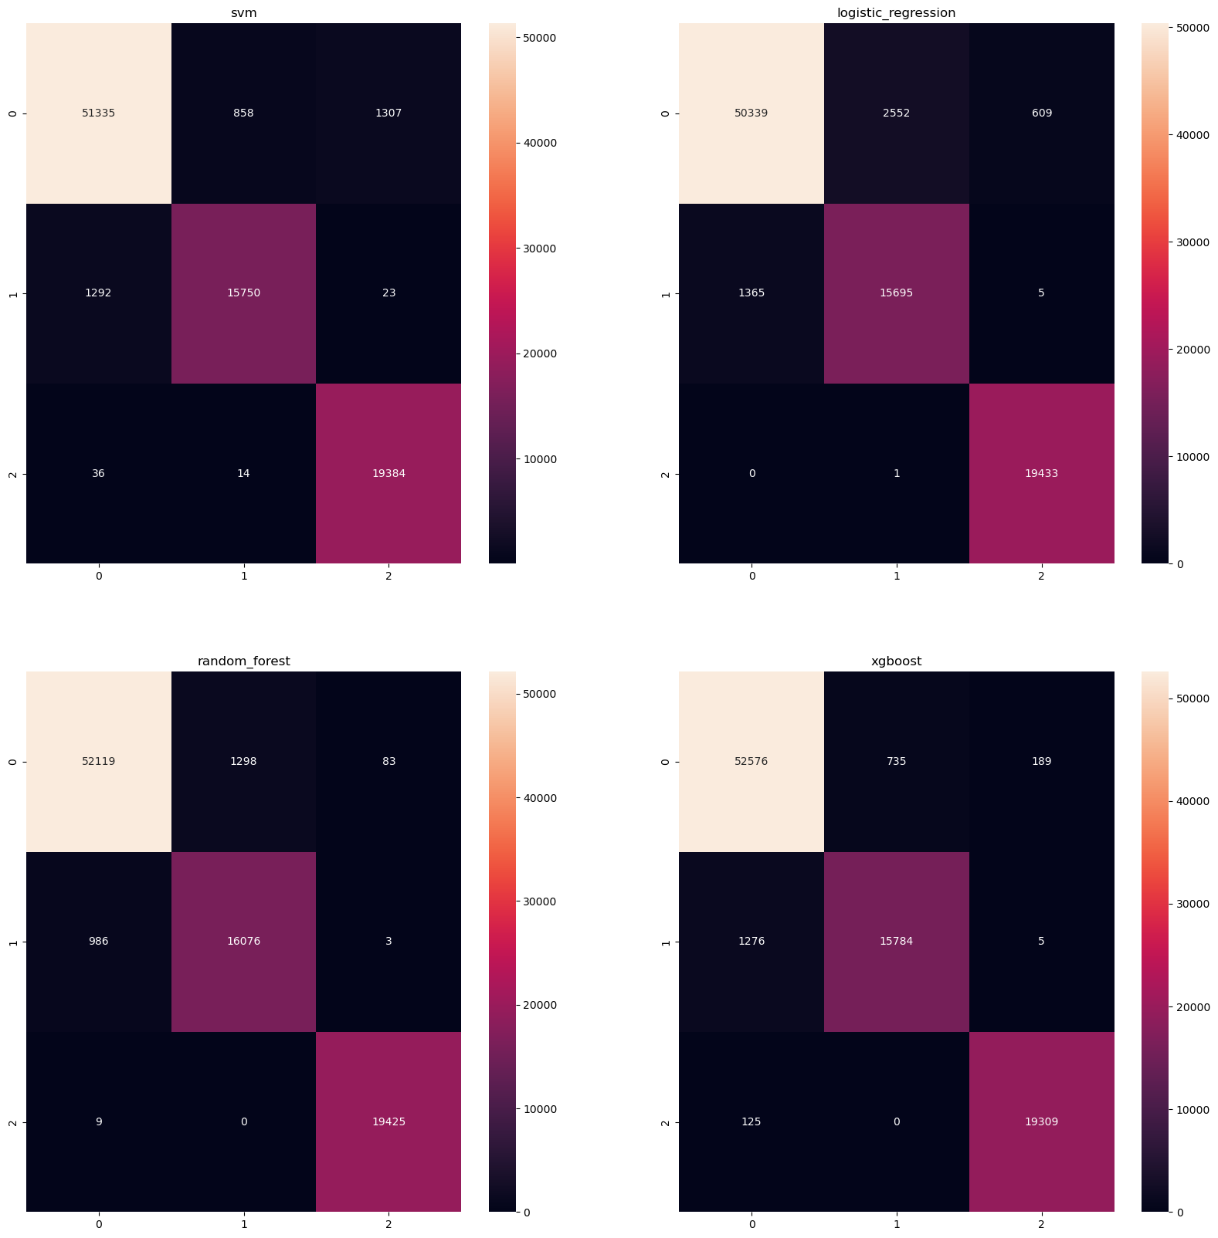
Model choice
0 – galaxy, 1 – quasar, 2 - star

Slide 9
Model choice
0 – galaxy, 1 – quasar, 2 - star

Slide 10
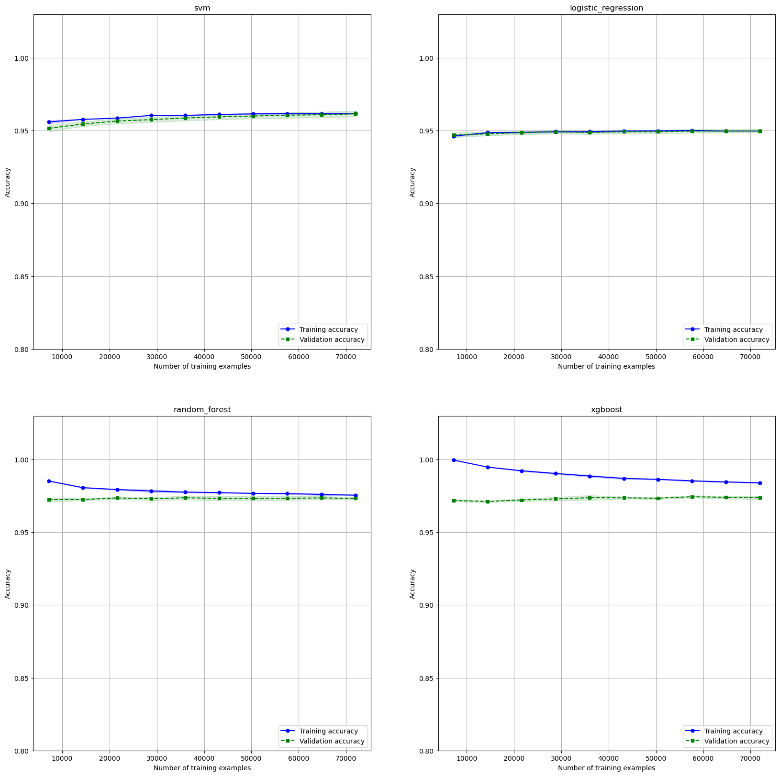
Model choice

Slide 11
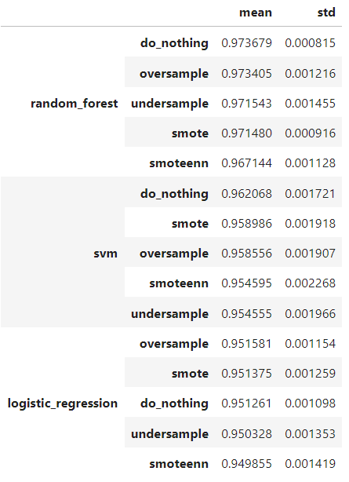
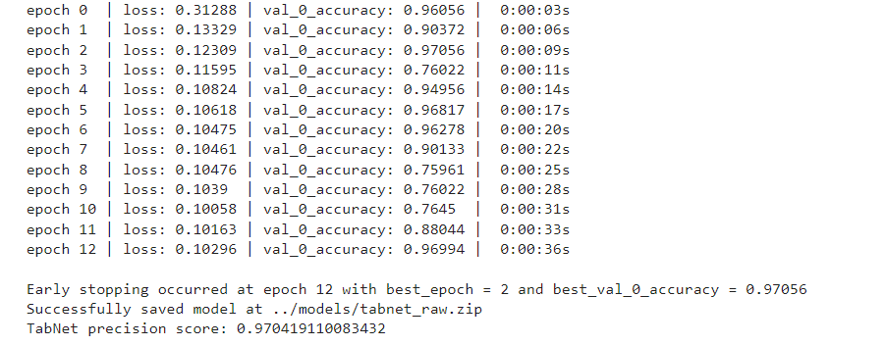
Model choice
Imbalanced learning techniques comparison (imbalanced-learn package) – unsatisfying results
Neural networks: scores comparable to the simpler models
Metric: weighted precision

Slide 12
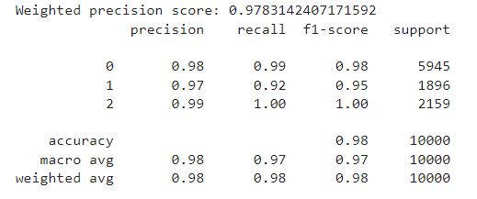
Model validation
Final model choice:
Random forest with hyperparameters:
n_estimators: 259, max_depth: 13, criterion: entropy, max_features: log2, class_weight: None
The behavior and results of the selected model have been verified by an independent validation team.

Slide 13
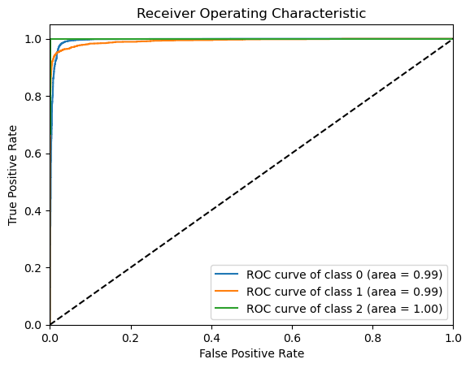
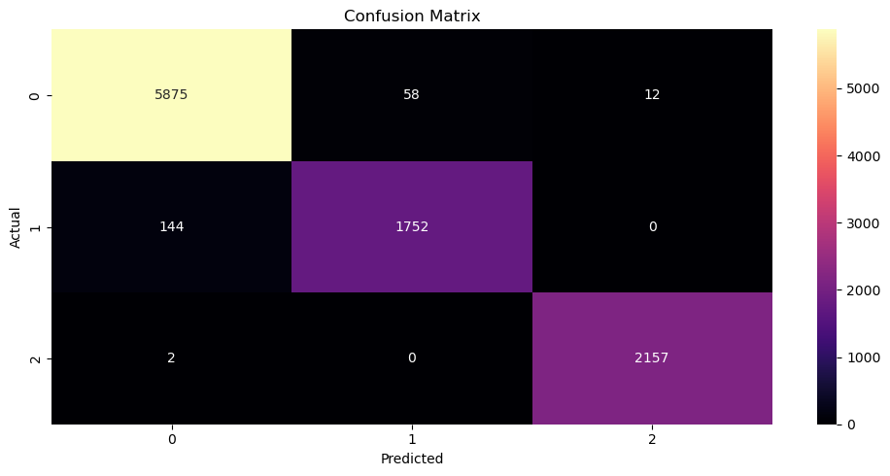
Model validation
0 – galaxy, 1 – quasar, 2 - star

Slide 14
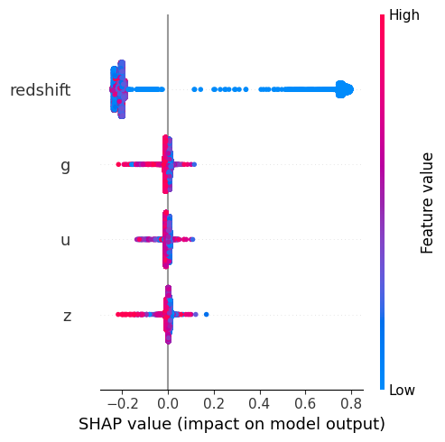
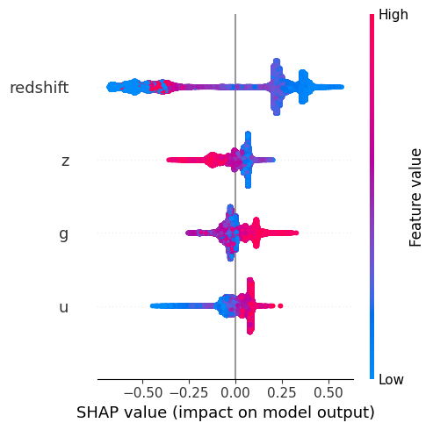
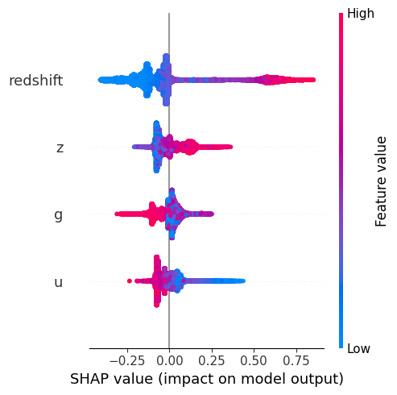
Model explainability
Star
Galaxy
Quasar

Slide 15
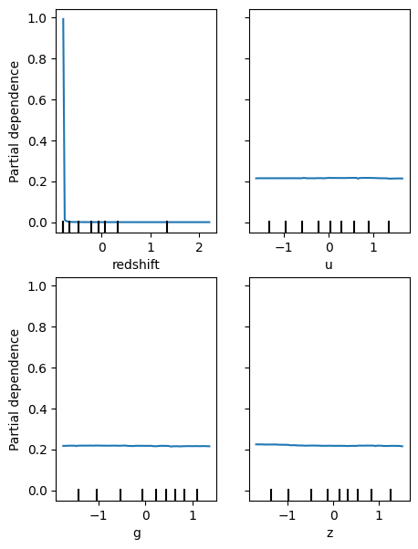
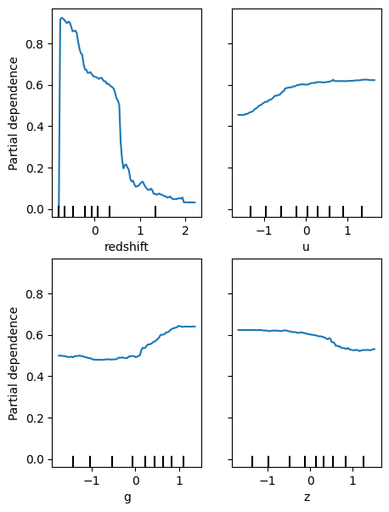
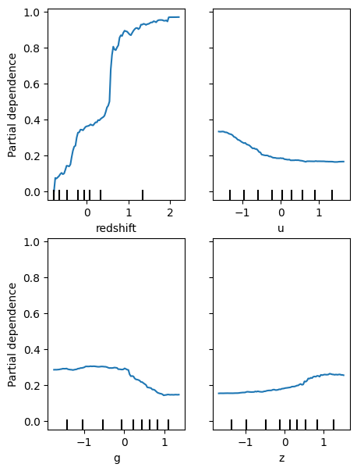
Model explainability
Star
Galaxy
Quasar

Slide 16
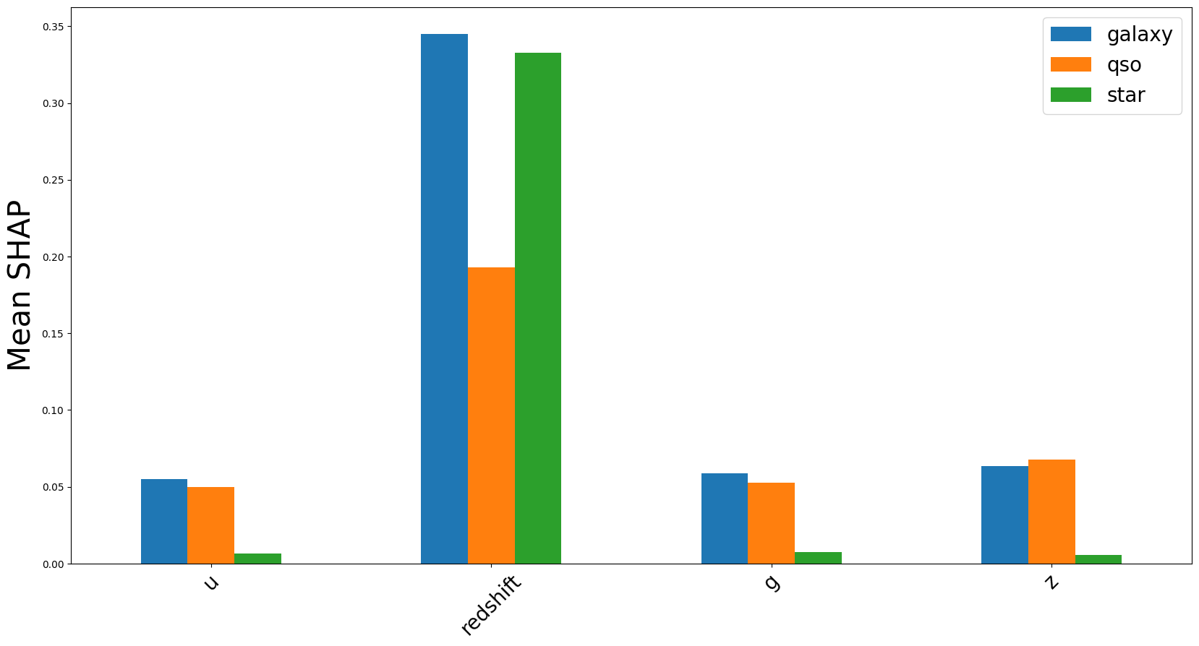
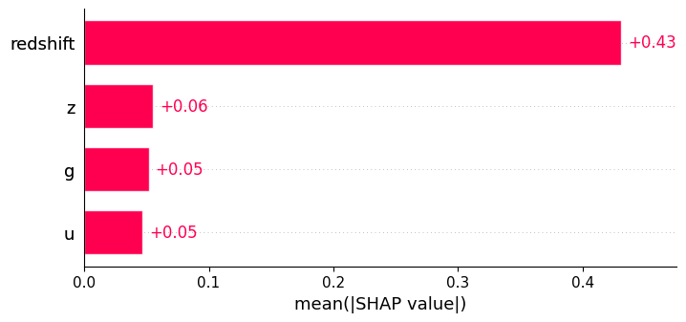
Model explainability
Mean abs shap
Mean abs shap for the predicted class

Slide 17
Final result
We managed to create a model that is:
simple
explainable
highly precise
This model can efficiently and reliably classify celestial bodies, thereby supporting the work of astrophysicists.

Slide 18
